Slide 1
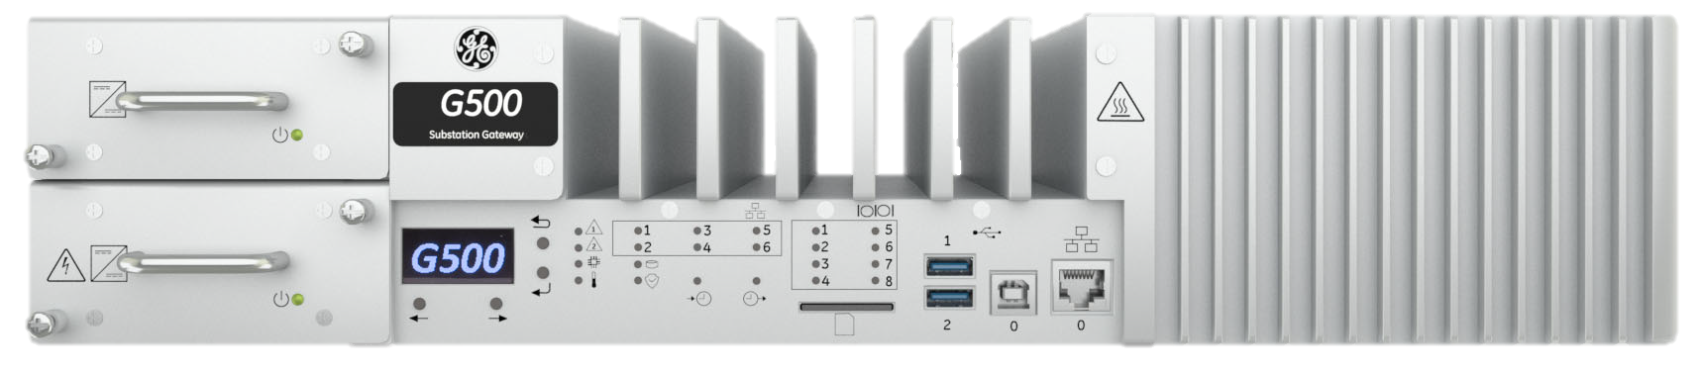

1050-
G500 Hardware
Learning & Development
Learning Module
REV A
G500-1050 l G500 Hardware Rev A v1
SME Source Markham

Slide 2
Learning & Development
Objective
Learning Module Objective
At the completion of this module you will be able to identify and recite all concepts presented.
If you are viewing this as part of a structured training program PLEASE complete the
associated assessment test. You are required to score above 80%.
Learning Module Objective
G500-1050 l G500 Hardware Rev A v1
SME Source Markham

Slide 3

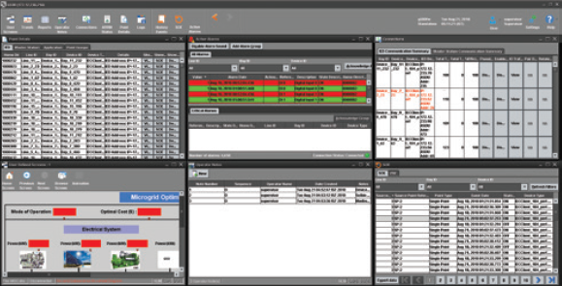




Monitor
Control
Automation
Security
Data acquisition
Automatic control
Data collection from the field devices/sensors
Interconnection with the plant DCS
Local HMI
Substation automation
Energy Management System
G500
Advanced Gateway
Data collection from substation IEDs, for control & secure monitoring
Embedded HMI
Customizable local or remote HMI with multiple windows
Advanced Automation
Automate substation procedures using IEC 61131 compliant tools
Secure Remote Access
Securely access substation device locally and remotely
Fault Recording & Data Logging , File Retrieval
Extract valuable data such as digital fault records and event files
IEC 61850
Support for IEC 61850 Edition 2 (Client) with simplified configuration
The Multi-function Controller Platform (MCP) G500 data concentrator hardware incorporates cutting edge gateway technology with a state-of-the-art communications architecture to facilitate the smoothest combination of control, communication and monitoring in industry.
1050 – G500 Hardware
Notes:
GE’s Multilin G500 is a member of the advanced Multi-function Controller Platform (MCP). This platform offers a high-capacity, secure, future-proof, and substation-hardened set of modular and scalable hardware and software components designed to simplify deployment, operation and maintenance of automation systems for a variety of applications including:
• Centralized automation for transmission & distribution substations
• Industrial substation automation systems
• Asset performance management
• Distribution automation & microgrid
• Secure substation automation systems
• Retrofit of substation automation systems
The MCP makes it possible for a single device to host multiple functions and applications such as Supervisory Control and Data Acquisition (SCADA) Concentrator, Remote terminal Unit (RTU), Human Machine Interface, Advanced Cyber Security Features, and Non-Operational Data Storage. Consolidation of functions reduces the cost of deployment and operation while increasing system reliability through a reduced number of devices in the system.
The G500 is designed to provide a reliable and accurate collection of data (metering, status, events and faults) from serial or LAN-based intelligent substation devices to master applications such as SCADA, EMS, DMS, DCS or other enterprise applications. With its modern and robust cyber security features, the G500 is designed for smooth integration into NERC CIP and cyber security environments while consolidating functions such as Ethernet communications, time synchronization, HMI and SCADA applications.

Slide 4
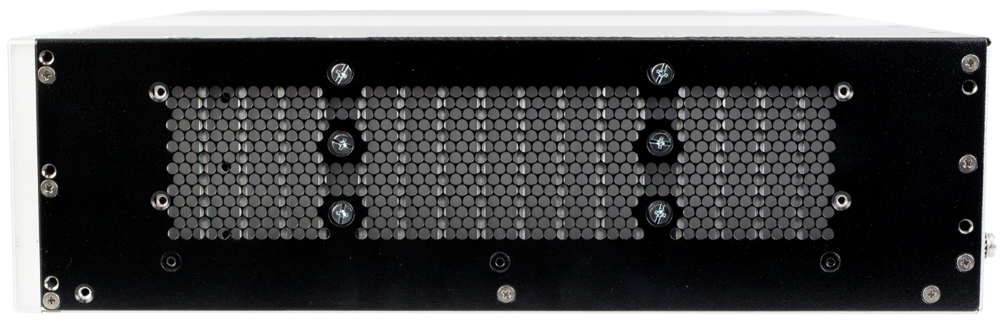
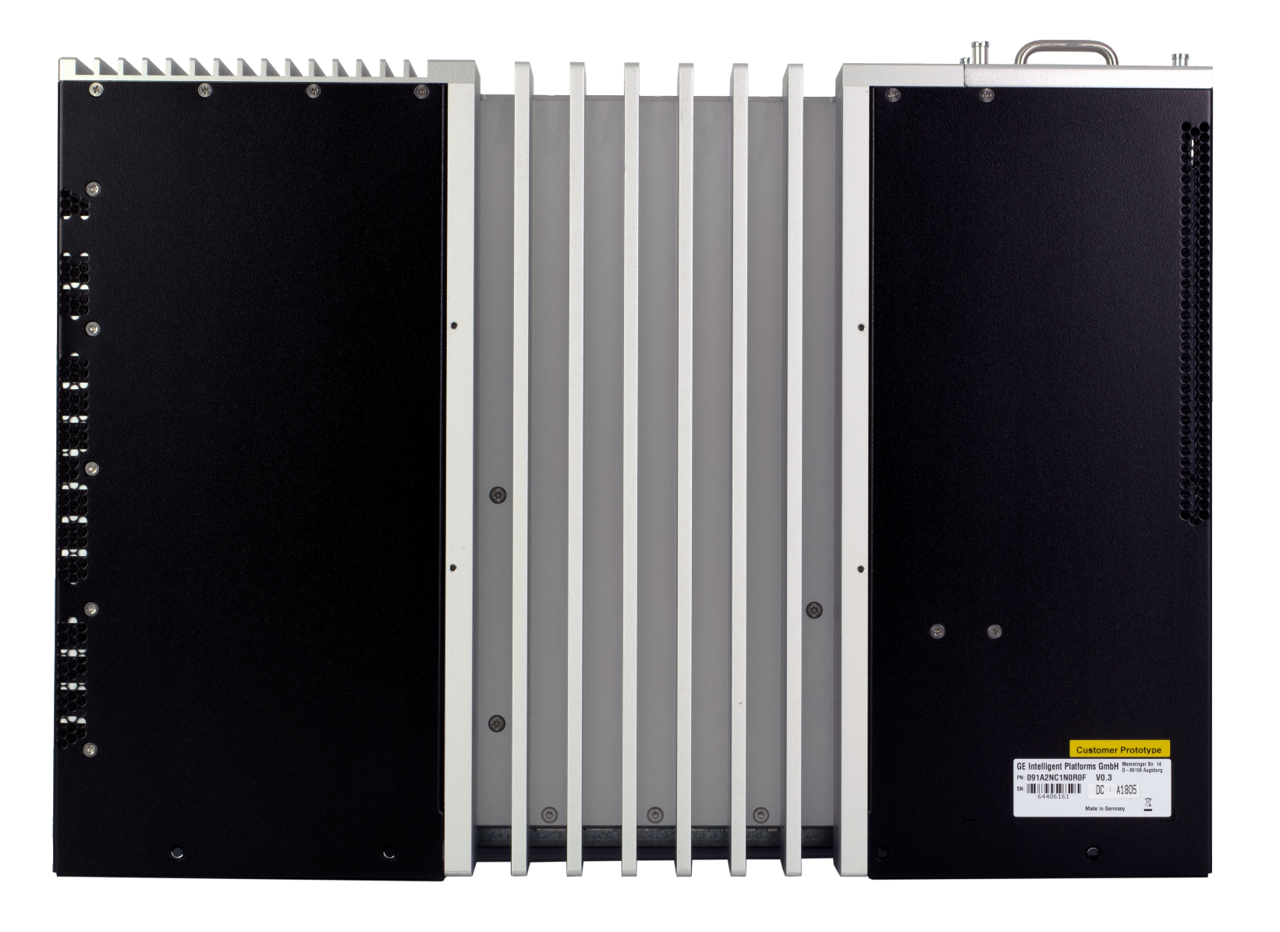
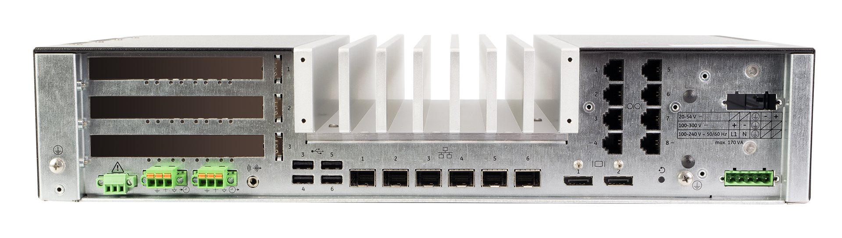
Physical Views
Front View
Side View
Front view
Back View
Top view
Side view
Front view
Back View
Top view
Side view
Top View
Rear View
1050 – G500 Hardware
Notes:
The formfactor of the G500 front and back were designed for intuitive connections and indicators were placed in order to provide and support operators and installers during their tasks whether it is installation, monitoring or control.

Slide 5
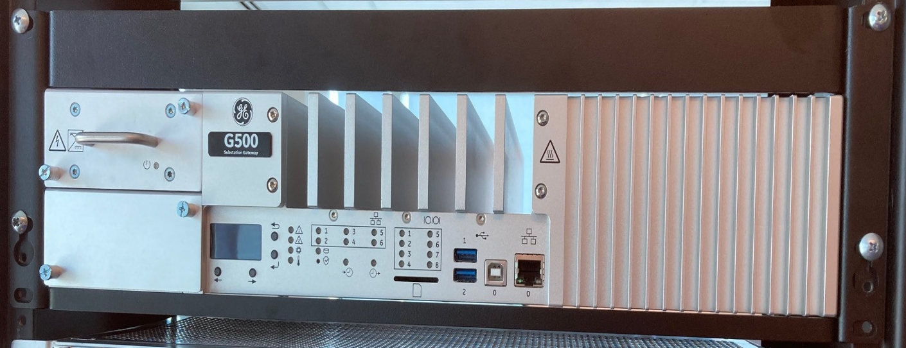
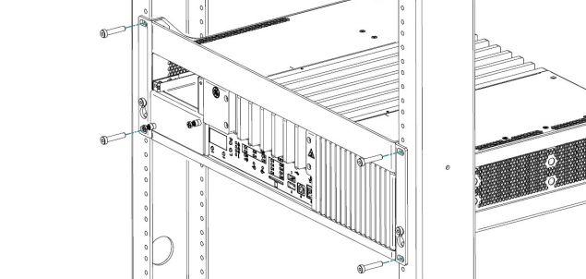
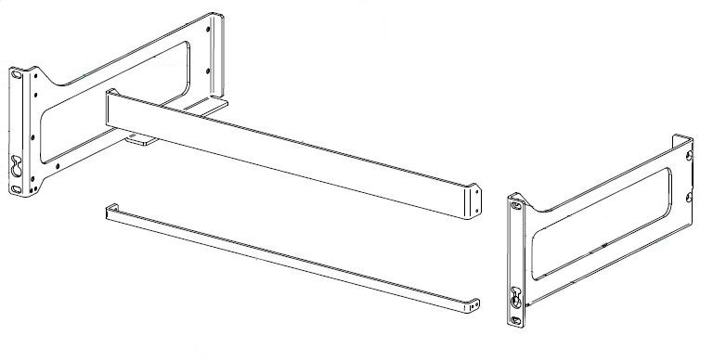
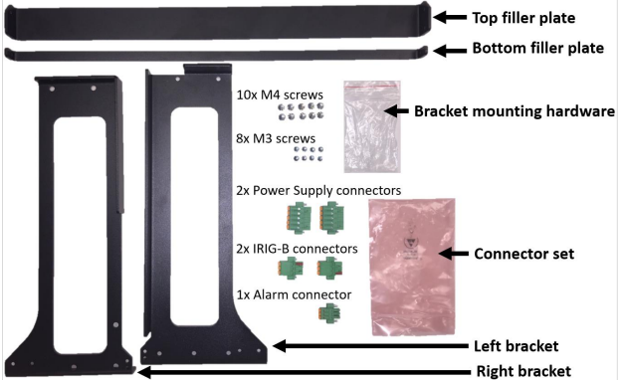
Hardware Options
2 or 4 core
8 or 16 GB RAM
128 or 256 GB SSD
CPU:
2 core AMD 2.2 GHz processor
4 core AMD 2.7 GHz processor
Inquire with marketing team for updated cpu options
Memory, Storage:
8 GB RAM, 128 GB SSD
16 GB RAM, 256 GB SSD
Operating Temperature:
-40°C~70°C continuous run for 2 core CPU
-40°C~60°C continuous run for 4 core CPU
HW Compliance:
IEC 61850-3, IEEE 1613.
CE Mark, UKCA, UL Mark, REACH, RoHS.
TPM 2.0.
Mounting Options:
Rack Mountable (3U) – thermal gaps for proper ventilation.
1050 – G500 Hardware
Notes:
G500 provide competitive options for different needs of automation and control application. G500 is designed for harsh environment installation, and to meet industrial compliance. G500 is provided with brackets that would enable installation in 19” rack.

Slide 6
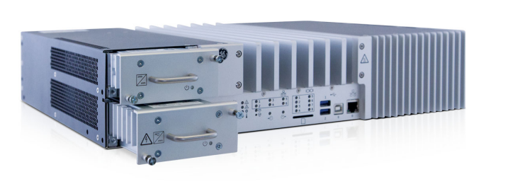
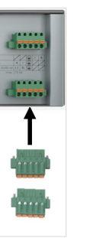
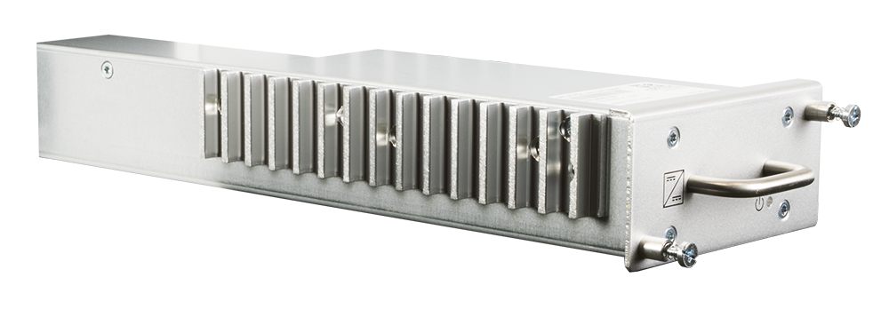
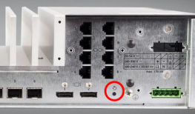
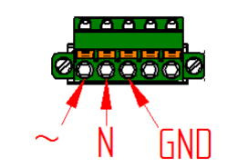
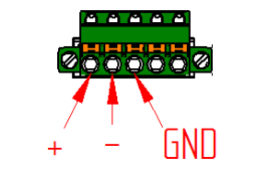
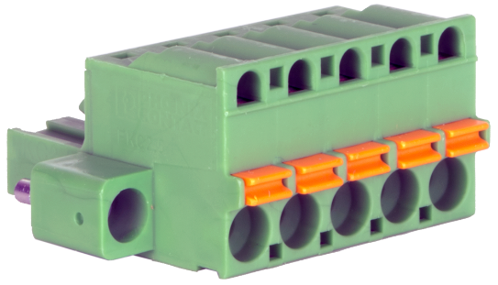
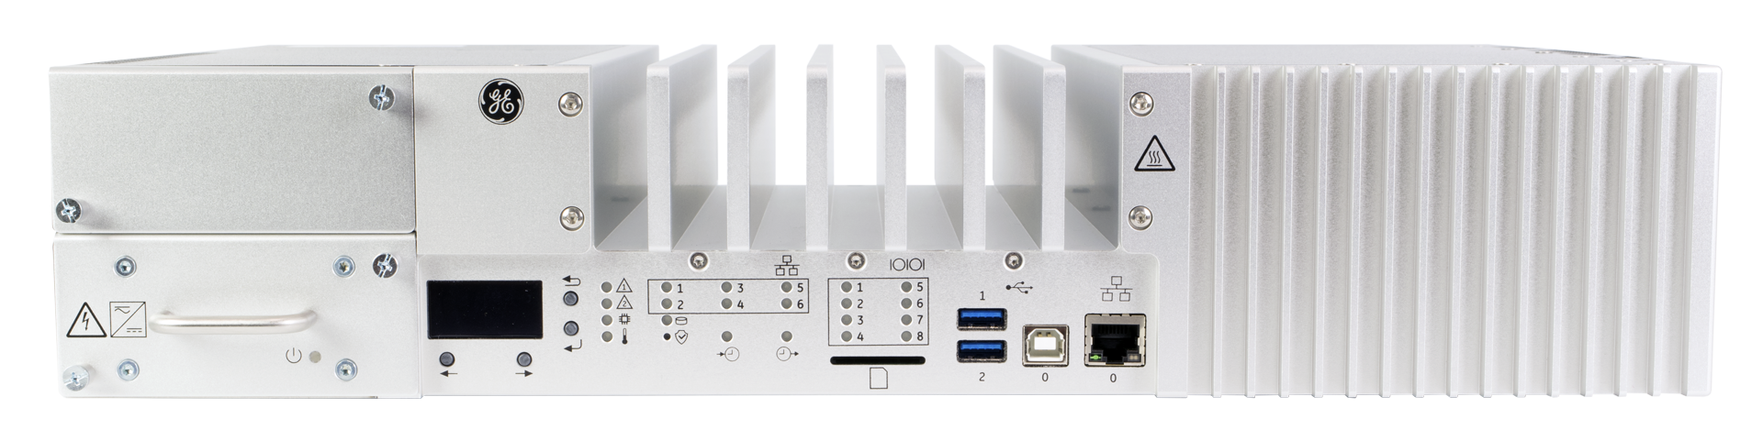

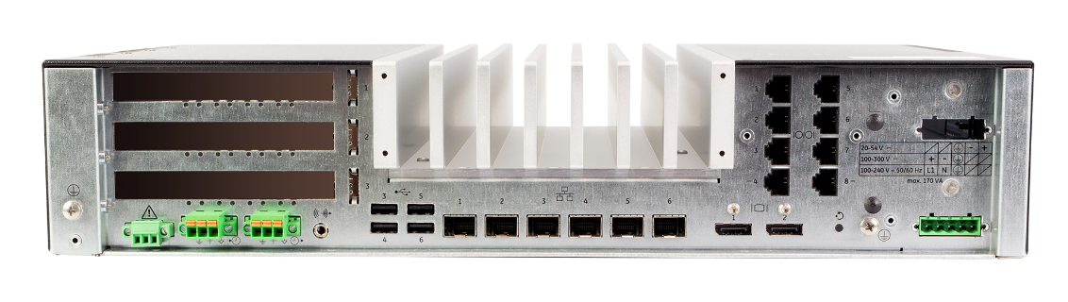
Power Supply
    Dual/ Redundant hot-swappable HV and LV power supplies.
    HV: 100–240 VAC, 100–300 VDC.
    LV: 20–54 VDC.
    Power supply status LED.
    Ground screw.
    Separate HV and LV power supply inputs.
    Recessed system reset button.
Hot swappable power supply
Recessed system reset button
Press and hold 1 second – Graceful shutdown
Press and hold 5 seconds – Abrupt shutdown
Unit restarts after 120 seconds
Please note: SD Card slot is disabled and has no driver in G500.
Blank if redundant power supply is not ordered/present.
Rear power supply connector and labeling.
Ground screw
Mandatory
Ground screw
Reset button
1050 – G500 Hardware
Notes:
G500 is equipped with two dual hot swapable power supplies. As you can there is a ground screw and recessed reset button, for the reset button if you do
A momentary press (1 second) the reset button will gracefully shutdown the G500 and remain off for 120 seconds, the front CPU LED will be orange for this duration. After 120 seconds the G500 will automatically restart, and the front CPU LED will turn green. The 120 seconds off period is to allow users time to disconnect power from the G500. A press and hold (5 second) of the reset button will abruptly shutdown the G500 and remain off for 120 seconds, the front CPU LED will be orange for this duration. After 120 seconds the G500 will automatically restart and the front CPU LED will turn green.

Slide 7
OLED Display with Navigation
  OLED display
    64x128 pixels
    Model number
    Order codes and hardware diagnostics (future)
  Navigation buttons (Right, Left, OK, Escape)
Future improvement for presentation of information.
1050 – G500 Hardware
Notes:
In the future the OLED display allow for navigation through the mini-screen, basically there is four buttons right, left, OK and Escape.

Slide 8
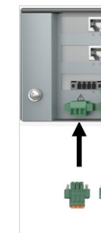

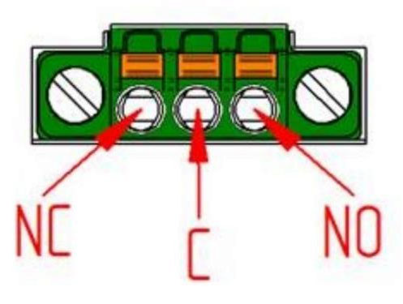
Hardware Status LED
  Status 1 – This Gateway
  Status 2 – Peer Gateway : apply when G500 is redundant.
  CPU and power supply status – power rails indicator.
  Temperature indicator - Over 10 internal monitored points.
Hardware Status LED
This Gateway Status
Peer Gateway Status
CPU status
Temperature
Watchdog Alarm Output
Hardware status LED
This Gateway Status
Peer Gateway Status
CPU status
Temperature
Watchdog alarm output
Watchdog alarm output (NC and NO)
1050 – G500 Hardware
Notes:
Also there is LED’s that indicate G500 redundancy, cpu, thermal and power supply status indicators. G500 also has software and hardware system fail alarm indicators.

Slide 9
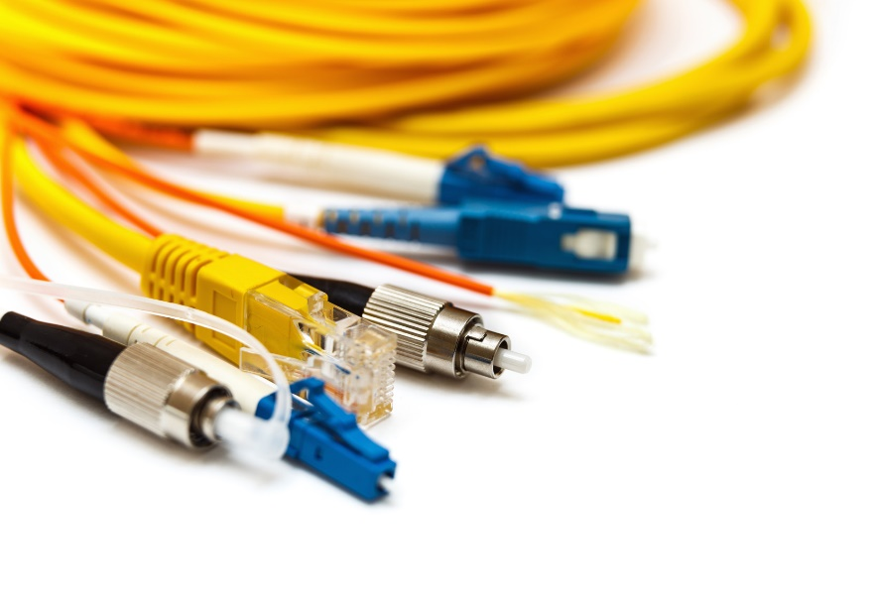
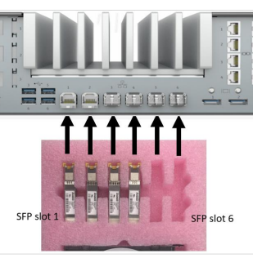
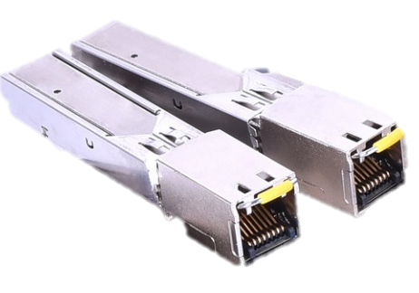
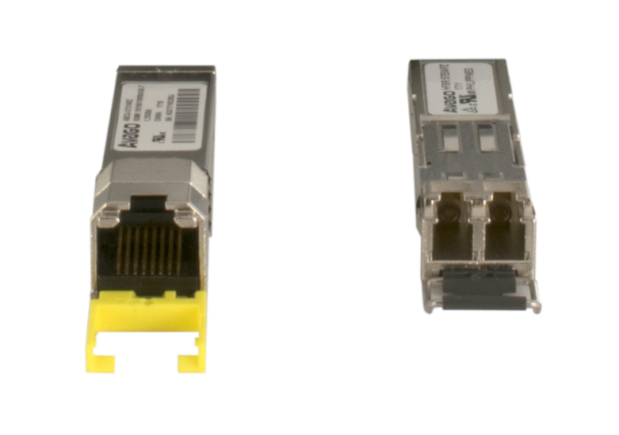
Ethernet Interfaces
Network indicators
Activity and speed.
Green and orange
Off if no link or no SFP.
Six locking Small Form-factor Pluggable (SFP) Ethernet ports:
100BASE-TX (RJ45 copper)
1000BASE-TX (RJ45 copper)
100BASE-FX (LC fiber multimode)
1000BASE-SX (LC fiber multimode)
1000BASE-LX (LC fiber single mode)
Independent MAC and IP
3 Parallel Redundancy Protocol (PRP) pairs
Front 100/1000BASE-T maintenance Ethernet port ( Isolated)
Network port activity indicator LEDs (activity and speed)
GRN = 1000Base, ORG = 100Base
Off with no link or no SFP inserted, flashes for activity
1050 – G500 Hardware
Notes:
G500 come with many options for SFP’s :
100BASE-TX (RJ45 copper)
1000BASE-TX (RJ45 copper)
…(and so on).
LED’s will be green for the 1000 base and orange for the 100 base.

Slide 10
SSD Drive Activity
SSD drive activity
Physical presence button
Drive activity indicator.
Physical presence button.
Puts unit in update mode.
Makes it impossible for intruder to remotely modify UEFI, boot order, boot media
1050 – G500 Hardware
Notes:
Another important LED is to allow access of SSD which is next to the physical presence button. The physical presence button can be used during firmware upgrade procedure in the G500 to boot from USB to apply upgrade physically at the G500.

Slide 11
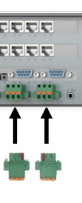
IRIG-B Clock Input and Output
1588 PTP
NTP
IRIG-B Input and Output
SCADA – ex. DNP
Time inputs: IEEE 1588 PTP, IRIG-B, NTP, SCADA Protocols
IRIG-B input formats are B002 and B006
IRIG-B input indicator LED
  OFF = No signal, GRN = Valid signal, RED = Invalid signal
  ORG = Valid signal not synched/configured as B002
IRIG-B output generated using input IRIG-B.
IRIG-B output can be configured and enabled only when the IRIG-B Input is enabled
IRIG-B output is complaint to TTL, supported formats are B006/B002.
IRIG-B output indicator LED
  OFF = No output/disabled
  GRN = Output is present, and the internal clock is synched
  ORG = Output is present, but the internal clock is not synched
1050 – G500 Hardware
Notes:
G500 support IEEE 1588 PTP, IRIG-B, NTP, and SCADA Protocols for time synchronization. The G500 has IRIGB support both B002 and B006 format.

Slide 12
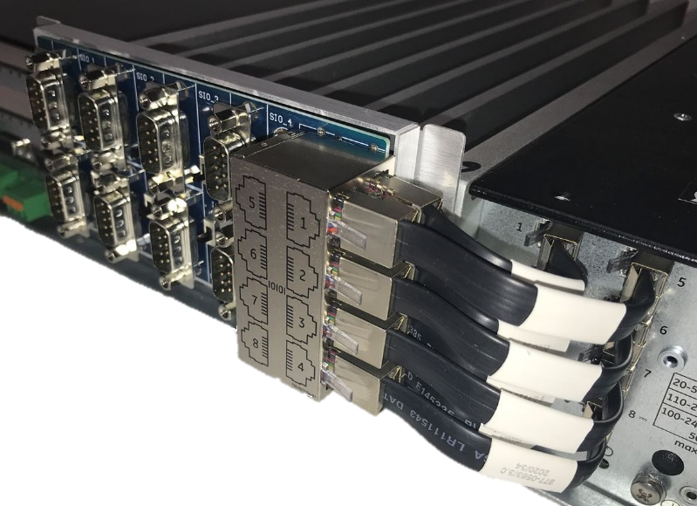
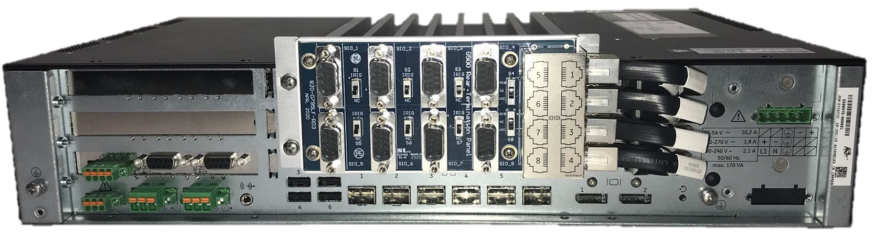
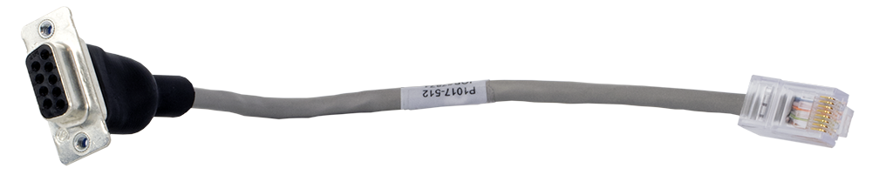
Serial Indicators
Green – Transmit
Red – Receive
Orange – Transmit and Receive
Serial board add-on kit includes
528-1006LF Main board.
977-0546 cables
977-0563 cables
Serial port activity indicator LEDs (send and receive activity)
OFF = No Traffic GRN = TX, RED = RX, ORG = TX + RX
Native 8 RJ45 RS232/RS485 serial ports
Ports individually isolated to 2kV
Software configurable parameters:
  RS232/RS422/RS485, 2w/4w
Termination resistors (via latching relays)
All include IRIG-B output
Ports 4 and 8 include 12V 500mA output on pin 7
Option: Rear RJ45-DB9 rear serial port transition panel adapter
Option: RJ45-DB9 adapter
1050 – G500 Hardware
Notes:
G500 has feasibility for 8 serial connectors. You can either use RJ45-DB9 or use a daughter board kit.

Slide 13
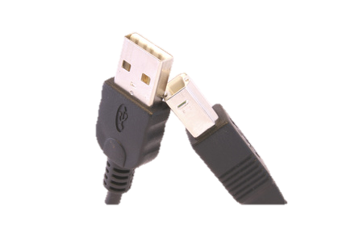
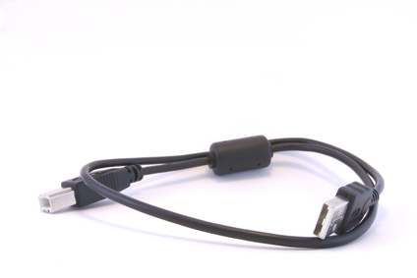
USB – Universal Serial Bus
Front and rear USB type A ports (6)
Front USB type B console port (1)
Front two USB 3.0 type A ports
Rear four USB 2.0 type A ports
Front one USB type B serial console port (Default settings: 115200 8N1)
Each USB port (1-6) is selectable in UEFI to be disabled/enabled.
1050 – G500 Hardware
Notes:
At the front of the G500 there is 2 USB 3 type A and a USB type B. at the back there is 4 type A usb ports.

Slide 14

Local HMI Monitor Display connectors
Note : G500 was designed with DP has mechanical latching while HDMI doesn’t have this capability.
Rear Two DisplayPort video interfaces
Display Port (DP) Version 1.2 and DP++ compliant
Up to UHD (4k, 3840x2160) for single display
Up to QHD (2560x1440) for multi-stream connected displays
1050 – G500 Hardware
Notes:
G500 has support for two HMI dp compliant ports.

Slide 15
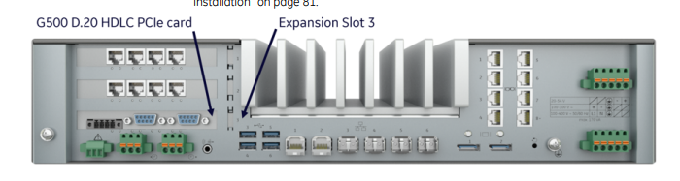
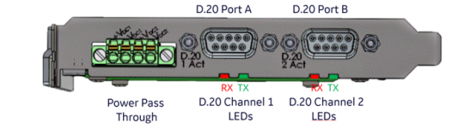
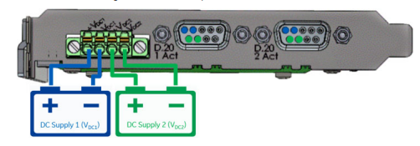
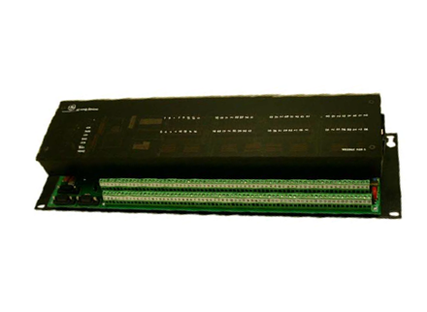
Support for 3 PCIe Expansion Modules
Support for 3 PCIe expansion modules
Two type PCIe expansion cards available now:
D.20 Link HDLC PCIe card
4-port Serial PCIe card
Only PCIe cards from GE should be used
D.20 Link HDLC PCIe Card
    Installed in Expansion slot 3 only
    Power supply terminal block for sourcing D.20 power.
    Two D.20 ports and four LEDs
    4-port Serial PCIe Card
    Up to 3 4-port RS232/485 cards
    Port 4 of each PCIe expansion card include 12V 500mA output on pin 7
1050 – G500 Hardware
Notes:
There is an expansion PCIe capability a common upgrade is fo the D.20 expansion card that allow G500 to communicate to D.20 devices.

Slide 16


Order G500
Online Store
Documents, Software
Sign Up for Notifications
GE Grid Solutions - Substation Automation Markham Technical Support Web Library | Powered by Box
https://www.gegridsolutions.com/multilin/catalog/g500.htm
https://store.gegridsolutions.com/ViewProduct.aspx?Model=G500
1050 – G500 Hardware
Notes:
This was a brief description of the G500 platform please feel free to visit our online resources to download manuals and access more support, hope to see you in future educational material.

Slide 17

Thank you for having watched this educational material

Slide 18

Thank you for having watched this educational material

Slide 19


