Slide 1
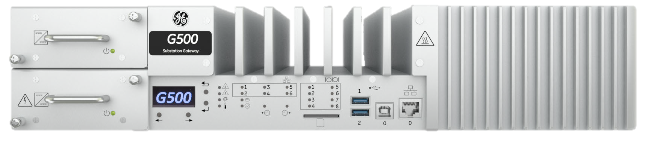

2050 –
G500 INITIAL SETUP
Learning & Development
Learning Module
REV A
G100 substation
automation
G500-2050 l G500 Initial Setup REV A v1
SME Source Markham

Slide 2
Learning & Development
Objective
Learning Module Objective
At the completion of this module you will be able to identify and recite all concepts presented.
If you are viewing this as part of a structured training program PLEASE complete the
associated assessment test. You are required to score above 80%.
Learning Module Objective
G500-2050 l G500 Initial Setup REV A v1
SME Source Markham

Slide 3
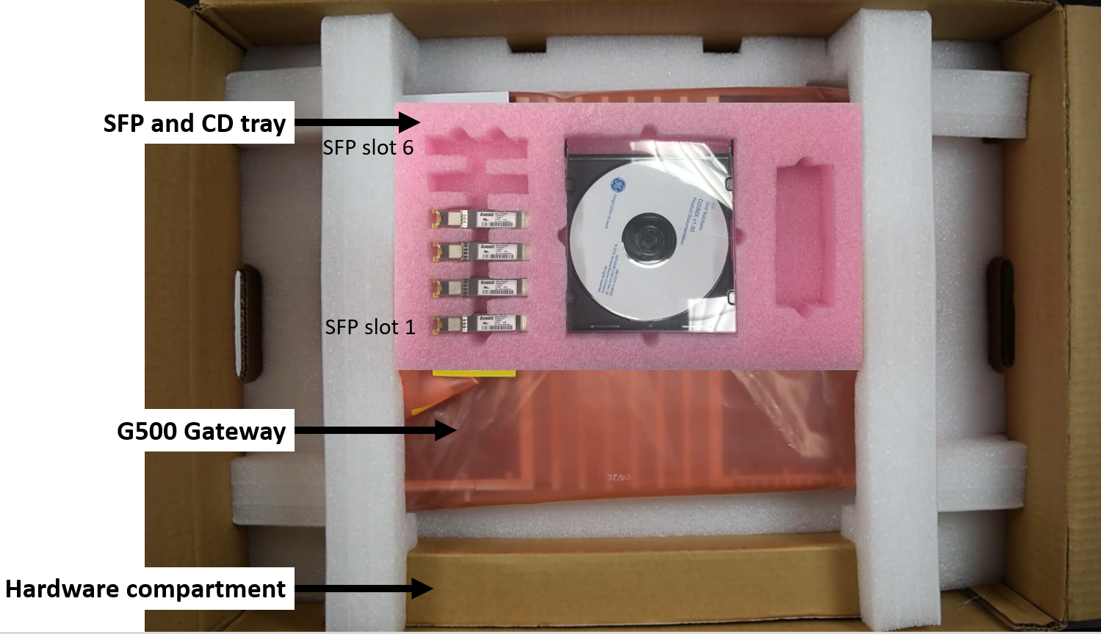
Your Kit Includes the Following:
  G500 Substation Gateway
  SFP and CD tray
  Hardware Compartment
Time to unbox:
Review instruction manual.
Observe all safety precautions.
Notes:
Please read the Instruction Manual carefully before unpacking the board or module or fitting the device into your system.
Observe all safety precautions and keep all original packaging material for future storage or warranty shipments of the board.
Your kit includes:
G500 Substation Gateway
SFP and CD tray – CD tray has the required documentation and support resources
Hardware Compartment packet

Slide 4
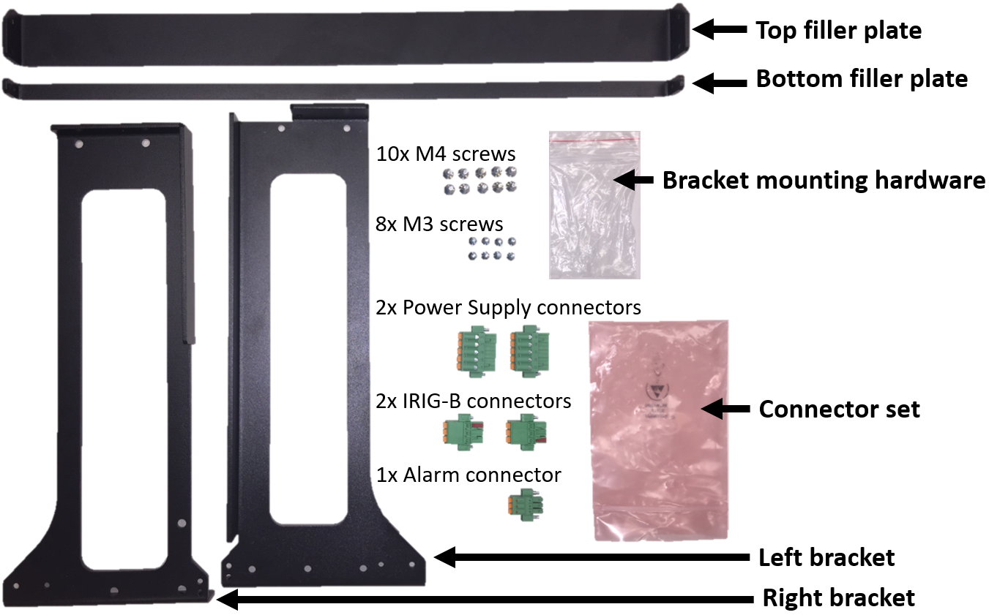
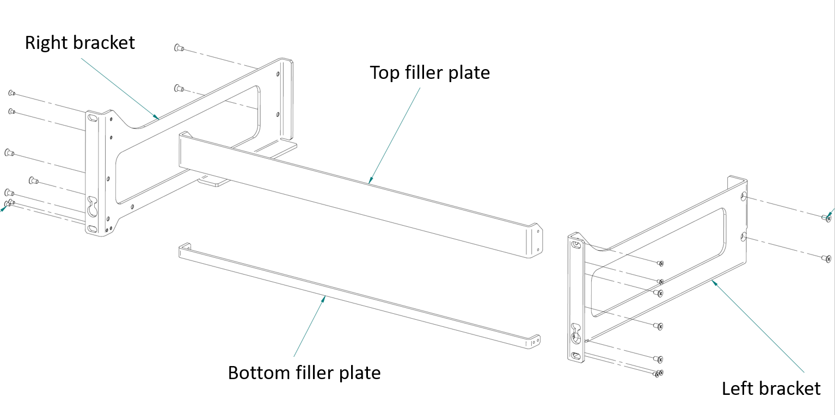
Hardware Compartment
The hardware compartment is a single packet which contains:
Mounting Bracket Kit | : | Top filler plate Bottom filler plate Left bracket Right bracket
Bracket mounting hardware | : | M4 screws (quantity 10) M3 screws (quantity 8)
Connector set | : | Power supply connectors (quantity – 2) IRIG-B connectors (quantity – 2 i.e. input and output connectors) Alarm connector (quantity – 1)
The M4 screws are used to attach the left and right bracket to the G500 chassis
M3 screws are used to secure the top and bottom filler plates to the brackets.
Notes:
As part of the Hardware compartment packet, the rack mounting kit includes 4 metal pieces; namely left bracket, right bracket, top filler plate and the bottom filler plate, along with M4 and M3 screws. The M4 screws are used to attach the left and right bracket to the G500 chassis and the M3 screws are used to secure the top and bottom filler plates to the brackets.
The G500 is mounted in 3U slot of a 19” rack by use of 6 screws that are compliant to IEC60297-3 standard with STD hole Pattern.
Before you install and operate the G500, read and follow the safety guidelines and instructions in “Safety precautions” on page 12 of the to (994-0152) Multilin G500 Substation Gateway Instruction Manual.

Slide 5
G500 Front Panel
The front panel of the G500 provides easy access to the status indicators, user connections and power supply units.
Notes:
This is a view of the G500 front panel.
The front panel provides easy access to the status indicators, user connections and power supply units.
A deep dive into the details of these indicators and the associated functionality is available in the G500 Instruction Manual and the training material on G500 Hardware

Slide 6
G500 Rear Panel
The rear panel provides access to the communication ports, field wiring connections and power connections.
Notes:
The rear panel of the G500 provides access to the communication ports, field wiring connections and power connections.
The G500 contains serial ports from the communication cards.
The communication cards are powered from the G500. The types of communication cards included in your unit depends on what was ordered for your substation application.

Slide 7
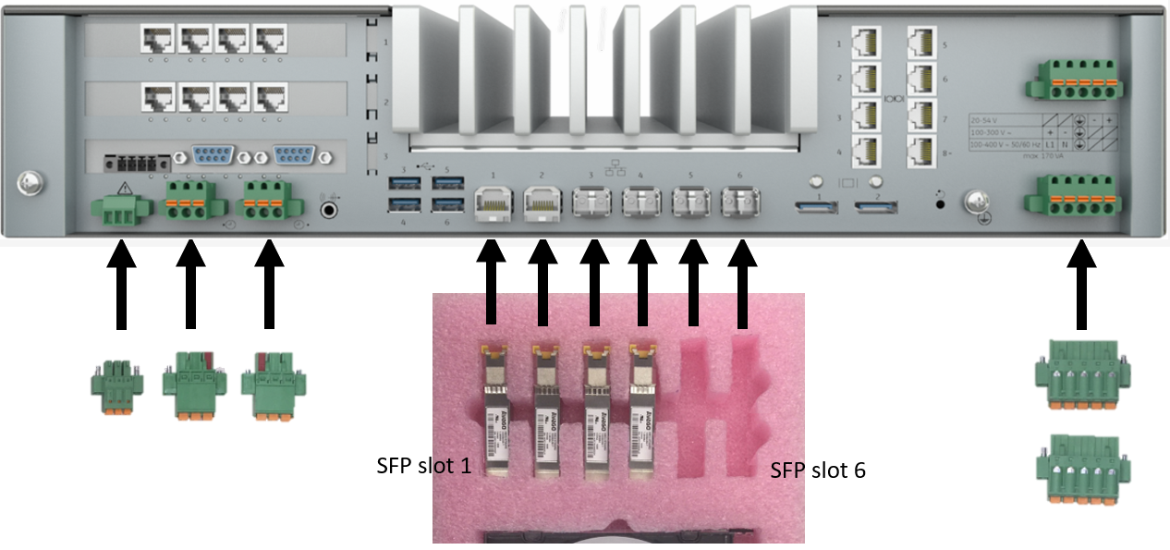
G500 Chassis Connectors
The SFP’s are inserted in the tray in the same order as the cages are labeled on the rear of the G500 chassis.
The IRIG-B input and output connectors are keyed and can only be installed in the corresponding position.
Notes:
There are six SFP slots available for Ethernet Interfaces at the rear of the unit. Into each slot an SFP module can be inserted in the same order as the cages are labeled on the rear of the chassis.
The single notch in the tray corresponds to the SFP cage labeled 1.
The Hardware compartment packet also includes the Connector set which includes two power supply connectors, one Alarm connector, one IRIG-B input and output connectors as shown in the presentation((point to the connector in the video).
The IRIG-B input and output connectors are keyed and can only be installed in the corresponding position.

Slide 8
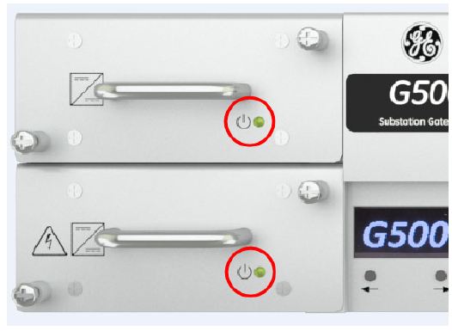
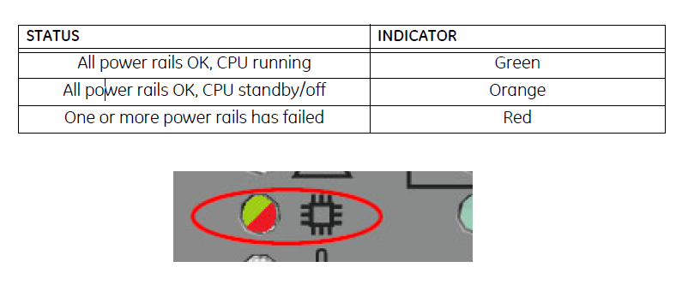
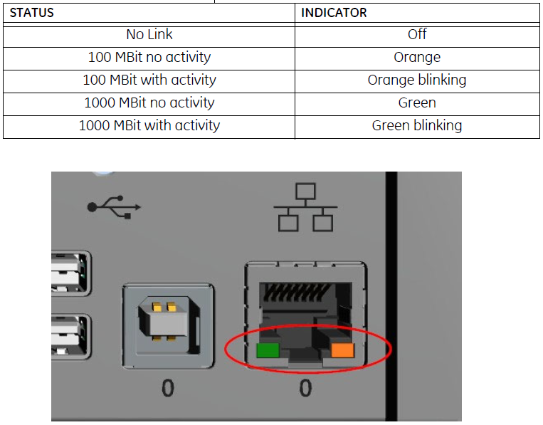
G500 LED Indicators
The G500 includes LED indicators for communication interfaces as well as additional indicators for different operational states on power -up
On power up look for the below LED Indicators:
Power
Green light indicates output 12Vd.c. is within acceptable range for proper operation of the power supply.
CPU
Green light indicates all power rails are OK and CPU is running.
Ethernet
Orange and green LEDs located on the front of the unit in the Ethernet connector housing indicate the status of the Ethernet link:
G500 INITIAL SETUP
Notes:
Once the unit is powered up, look for the Power, CPU and Ethernet indicators. On successful power up, Power and CPU indicator is Green, Ethernet indicators are Green or Orange depending on the link speed.

Slide 9
G500 Redundancy
A redundant setup allows a secondary G500 to automatically take over operations from a paired G500 unit that has failed.
To implement a redundant G500 system, you need the following components:
Component | Function | GE part number
RS232 Switch Panel | Communications switch | 517-0247
Power Supply | Power supply to power the RS232 switch panel. Input: 85 – 264 VAC or 90 – 350 VDC. | 580-0046
G500 RJ45 to RS232 Serial Cable | Connects the G500 to the RS232 switch panel which is then connected to external field devices. | 977-0556/LLL
Watchdog Cable Assembly | Connects G500 A to the RS232 switch panel. | 977-0557/LLL
 | Connects G500 B to the RS232 switch panel. | 977-0558/LLL
Ping Cable Assembly | Links both G500 units to facilitate a heartbeat message that determines the status of the active unit. | 977-0559/LLL
G500 A/B RS232 Switch panel Jumper (P1/P9) | Connects the isolates common of serial port to the signal used in switch panel so G500 (A or B) can make itself the active unit. | 977-0562
Power/ALARM Cable | Connects the RS232 switch panel to an external power supply and to the G500 ALARM terminal block. | 970-0161
Ground Cable | Provides a ground connection for the RS232 switch panel. | 970-0182
(/LLL) is length of the cable in inches, i.e. 36inches is /036
G500 INITIAL SETUP
Notes:
There is a list of components needed to implement G500 redundancy.
Redundancy requires two identical model and configuration units and zero, one, or two RS232 switch panels when connecting to RS232 devices.
RS232 switch panels are not required when connecting to RS-485 devices.
Refer to (994-0152) Multilin G500 Substation Gateway Instruction Manual for more details on Redundancy wiring and configuration

Slide 10

Product Documentation
MCP Product Documentation Set:
Includes all available documents for both G500 and G100
MCP Software Configuration Guide:
Provides detailed information on how to configure the MCP software
Quick Start Guide:
SWM0106 G500 Substation Gateway Quick Start Guide
Instruction Manual:
994-0152 G500 Substation Gateway Instruction Manual
Technical Support Library:
GE Grid Solutions - Substation Automation Markham Technical Support Web Library | Powered by Box
G500 INITIAL SETUP
Notes:
There is key documents available and the Technical Support Library points to the documentation and support repository.
The link takes you to the Tech Support page where you can select the G500 Substation Gateway, RTU and Controller folder.
In the technical support library, you can select the desired firmware version folder to see the list of available documents and support resources

Slide 11


G500 Release Notes
Outline key features, capabilities, and known issues within the MCP at the time of release.
Technical Support Library:
GE Grid Solutions - Substation Automation Markham Technical Support Web Library | Powered by Box
Product Website:
https://www.gegridsolutions.com/multilin/catalog/g500.htm
Online Store:
https://store.gegridsolutions.com/ViewProduct.aspx?Model=G500
G500 INITIAL SETUP
Notes:
The Release notes outline key features, capabilities, and known issues within the MCP at the time of release

Slide 12

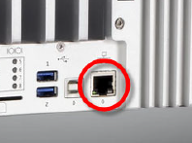

G500 Interface Options
The following connection / interface options are available after G500 first power up:
Local KVM (Keyboard, Video and Mouse) :
  Connect the Display Port to a monitor with a display cable.
  Connect a keyboard and mouse to any of the USB ports.
Maintenance Ethernet Port:
  100/1000 Base-T Maintenance Ethernet Port accessible via front of the unit.
  Default IP address: 192.168.168.81
Serial Maintenance Port:
  USB 2.0 type B serial console port on the front of chassis.
  First time users will have to install the required USB serial drivers from GE.
  Allows access to Console for debug.
  Default settings - 115k baud rate, 8 data bits, no parity and 1 stop bit (abbreviated as 115200 8N1).
KEYBOARD
KVM
VIDEO
MOUSE
G500 INITIAL SETUP
Notes:
Once the unit is powered up, there will be several interface options are available for connecting to the device. This includes Local KVM, Maintenance Ethernet Port and Serial Maintenance port.
Please refer to the next video on G500 Access to get more information on the connection/interface options.

Slide 13

Thank you for having watched this educational material

Slide 14

Thank you for having watched this educational material

Slide 15


